Slide 1
Know about health and safety in a logistics environment

Slide 2
Learning outcomes
State the key aspects of the Health and Safety at work Act (1.1)
Give examples of the most common types of accidents in a logistic environment (1.2)
Explain how accidents in a logistic environment impact employees (1.3)

Slide 3
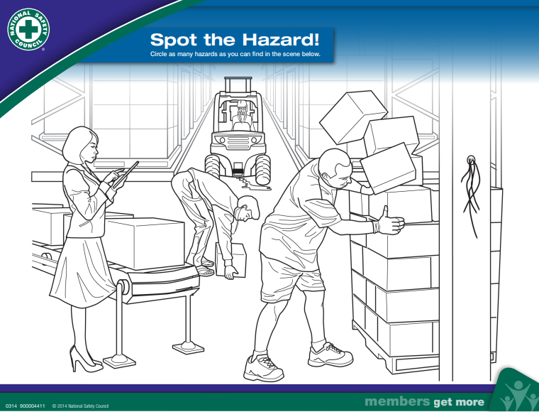
Icebreaker

Slide 4
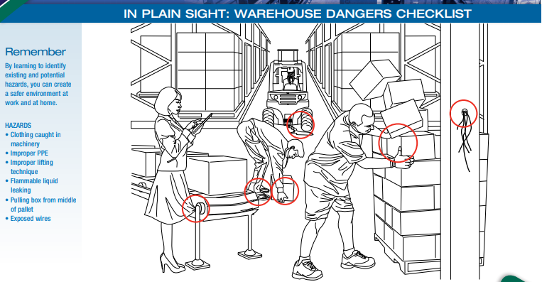
Icebreaker answer

Slide 5
Health and Safety Introduction
Over the last five years, accident reports sent to the Health and Safety Executive (HSE) and local authorities show that nearly 60 employees were killed and 5000 seriously injured in haulage and distribution - simply doing their job. Another 23,000 suffered injuries severe enough to keep them off work more than three days.
Health and Safety is there to help keep us safe and ensure we can work effectively in any environment.

Slide 6
State the key aspects of the Health and Safety at Work Act
What do you know about the Health and Safety at Work Act?

Slide 7

Health and Safety at Work Act 1974
Health and Safety At Work Act 1974 (HASAWA) covers all persons, outlining the basic responsibilities of employers and employees for safety while working.
Other sources of information that can help:
Your line manager or health and safety officer.
Your employee manual/H&S handbook.
Company intranet, noticeboards and policies.
Risk assessment and inspection reports.
Government websites such as gov.uk also give current information.

Slide 8

Health and Safety at Work Act 1974
Remember
An induction is essential part of your training, pay attention to the safety aspects and be familiar with company’s health and safety policy and H&S law poster.
Key point
Both employer and employees have legal duties under the Health and Safety work act 1974.

Slide 9
In the workplace employers and employees have legal responsibilities, what are these?

Slide 10
Legal responsibilities
A legal responsibility is something you have a duty to carry out to comply with the law.
Employers have many legal responsibilities, they include:
Obtaining the required licenses, permits and registrations to run their business
Safety procedures and processes
Protection of all from harm and risk
Controlling risks to injury or health that could arise in the workplace.

Slide 11
Employers
Your employers have the legal duty to:
Make the workplace safe and without risks to health where reasonably practicable.
Ensure plant and machinery is safe and that safe systems of working are in place.
Ensure articles and substances are moved, stored and used safely.
Provide adequate welfare facilities.
Provide training, instruction and supervision.
Have liability insurance to protect the business and the employees.

Slide 12
Employees
Employees have the legal duty to:
Co-operate with their employer on health and safety
Correctly use work items provided by their employer, including personal protective equipment, in accordance with training or instructions
Not interfering with or misusing anything provided for their health and safety

Slide 13
Self-employed
If self-employed you have the legal duty to:
Comply with the HSE regulations as the company would
Comply with the procedures of any company you provide a contractor service to
You must consider the work you are doing and judge for yourself if it creates a risk or not, taking appropriate action to prevent harm.

Slide 14

What is covered by legislation?
Warehouses are regulated by legislation, regulations and company procedures.
These include:
Buildings
Environment
Equipment used
Storage conditions
Individuals – workers of all kinds and visitors.

Slide 15
Legislation and regulation
We have already established that the Health and Safety at
Work Act is the primary law in keeping us safe.
What are the others?
Other regulations include:
RIDDOR (the Reporting of Injuries, Diseases and Dangerous
Occurrences Regulations 2013)
LOLER Lifting Operations & Lifting Equipment Regulations 2021
PUWER Provision and Use of Work Equipment Regulations 2021
COSHH Control of substances Hazardous to Health Regulations 2022
WAHR Working at height regulations 2005

Slide 16
Enforcement
How are Health and Safety laws enforced?
The Health and Safety at Work Act 1974 (HASAWA) gives safety inspectors powers to enforce safety standards among employers. As well as giving advice to employers and union safety reps.
Safety inspectors can take action against employers, for example:
Issue an Improvement Notice, requiring an employer to take action to put things right within a specified time.
Issue a Prohibition Notice, requiring an employer to stop hazardous operation if there is an immediate risk of danger to workers.

Slide 17
HSE & local authorities
Inspectors for the HSE or the LA have several rights, including the authority to:
Enter premises at any reasonable time.
Examine and investigate the premises, as well as request it to be left undisturbed.
Take samples and photographs and remove equipment or substances if deemed necessary.
Seize, destroy or render harmless, any article or hazardous substance if they deem it necessary.
Request the production of relevant documentation.
Issue an enforcement notice and initiate a prosecution.

