Slide 1
Know about health and safety in a logistics environment

Slide 2
Give examples of the most common types of accidents in a logistic environment

Slide 3
Health and Safety
Major injuries
Most injuries (more than seven out of ten) are due to just four causes:
■ Slips and trips
■ Being struck by moving or falling objects
■ Falls from less than 2 metres
■ Manual handling. Most of these happen during loading and unloading.

Slide 4
Health and Safety
Deaths at work
Almost all deaths arise from just four kinds of accident, most often during loading and unloading or maintenance of vehicles:
■ Being struck by a moving vehicle
■ Falling loads
■ Falls from vehicles
■ Collapsing or overturning vehicles..

Slide 5
Health and Safety
Causes of Workplace Injury
Trips 19%
Manual Handling 36%
Falls from height 7%
Other 13%
Machinery 5%
Struck by a vehicle or object 20%

Slide 6
Safety & Security Considerations
Manual handling
and
Manual handling equipment
What do you need to consider before transporting a load?

Slide 7
Manual Handling
Questions to discuss:
What is Manual Handling?
What do you think we must consider when completing any manual handling task?
What could the dangers be of carrying out manual handling incorrectly?
How do we complete a manual handling task safely?

Slide 8
Manual Handling
If you need to carry out a manual handling task remember the following:
TILE.
T: (Task) Type of task (Pulling / lifting / pushing / carrying etc)
I: (Individual) The capabilities of the individual(s) carrying out the task
L: (Load) Size, shape, surface and weight of the item to be moved
E: (Environment) Inside or outside, ground conditions and weather..

Slide 9
Health and Safety
Types of Injuries caused by Manual Handling
Other 3%
Lower Limb 8%
Back 49%
Finger/Thumb 14%
Hand/Wrist 9%
Arm 10%
Torso 10%

Slide 10
Vehicle Safety
Mounting and dismounting from the lorry cab:
Many injuries can be avoided by drivers getting into and out of their vehicle, and trailers.
If you jump from the cabin, you can exert 12 times your body weight on your ankles, knees, hips and lower back? For an average driver, that is equal to a tonne of shock.
Injuries can be prevented if you maintain three points of contact when entering or exiting the cab. This mean having two hands and one foot or two feet and one hand on equipment at all times.
https://youtu.be/n4rTlC-Zp2g

Slide 11
Vulnerable People at Work
We must take people's vulnerabilities into account these can include:
Pregnant workers.
Workers with disabilities.
Young people.
Migrant workers.
Lone workers.
Older workers.
Remote workers

Slide 12
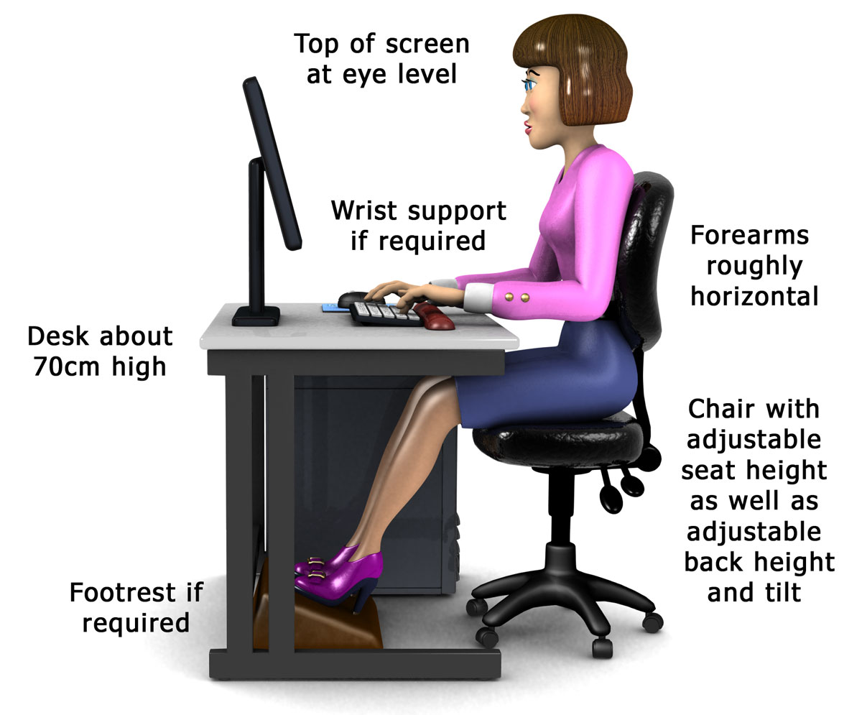
The approved precautions that can be used to minimise safety and security risks.
Consider:
Fully adjustable, stable seating
Wrist supports
Footrest if required
Space for movement
Having eyes cast down at a slight angle
High clearance under the desk
Key Point
Set up your workstation correctly. Report any problems of fatigue, discomfort or strains to your supervisor.

Slide 13
The approved precautions that can be used to minimise safety and security risks.
Look out for stress in yourself and colleagues
and report any concerns.
Some of the signs include:
changes in mood or behavior
relationships getting worse
performance problems
irritability, indecisiveness and anger
increased absenteeism
Speak to your immediate supervisor, HR or safeguarding team if you need help

Slide 14
Activity: how to reduce risks
What would you do?
The area is untidy so you should…….
Goods have been incorrectly stacked/placed?
You spot a spillage?
Manual handling is needed?
Pedestrians need to pass through the warehouse?
There are hazardous substances in a delivery?
There are visitors arriving?
‘Good Housekeeping, Clean as you go`.
Restack, move goods
Report immediately, trained person clean up
LITE (Load, Individual, Task, Environment) Assessment carried out. MHE – Trained operators only
Awareness / `Thumbs Up` / Walkways
Correct equipment and personal protective equipment. Trained personnel.
Security - Identification checks or searches /
CCTV / Authorisation

Slide 15
Activity: how to reduce risks
How would you reduce the risk to the work environment?
When unloading material
In the storage of raw material and finished product
When using MHE
With hazardous waste
In a fluid spillage
Operate safely in a well-ventilated area
Check labelling and isolate if required
Operate Safely
Dispose of the materials safely
Clean up the area as soon as possible

Slide 16
Explain how accidents in a logistic environment impact employees
How do accidents have an impact on employees?
How do accidents have an impact on employers?

Slide 17
Benefits & costs of staying safe
What are the benefits of GOOD health and safety?
What are the costs of POOR
health and safety?
Safer workplace
Legal compliance
Productivity is maintained
Healthier staff
Good reputation
Higher morale and staff retention
Satisfied customers
Reduced costs
Compensation
Legal costs
Productivity problems
Pain and suffering of staff
Prosecution
Cost of treatment
More accidents
Cost of clean up
Possibility of closure

Slide 18
Complete workbook: Working Safely in Logistics
Q1. State the key aspects of the Health and Safety at work Act (1.1)
Q2. Give examples of the most common types of accidents in a logistic environment (1.2)
Q3. Explain how accidents in a logistic environment impact employees (1.3)

Slide 19
Next Session
Know about personal protective equipment used in a logistic environment

