Slide 1
Know about health and safety practices and procedures in a logistics environment

Slide 2
Learning outcomes
State what employees should do in response to different health and safety incidents in a logistic environment (3.1)
Outline an employer’s health and safety responsibilities after an incident has taken place in a logistic environment (3.2)

Slide 3
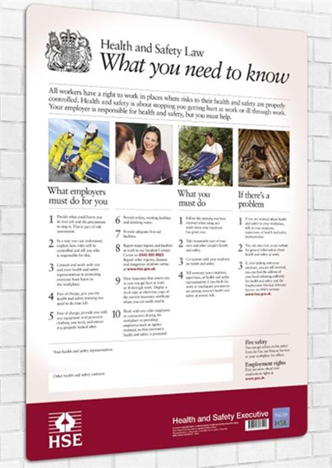
Health and Safety
Have you seen this poster displayed at key points in your work place?
Have you ever stopped to read it ?
Can you remember the responsibilities of your employer and our responsibilities as employees under H and S Law
(Ref: H & S Handout 1)

Slide 4
Health and safety incidents
State what employees should do in response to different health and safety incidents in a logistic environment
Group 1 | Group 2
Slips, trips, falls Crush injury from machinery Staff not complying with signs/rules | Manual handling injuries Crush injury from falling objects Not wearing the correct PPE

Slide 5
Procedures
Take control of the incident
Ensure first aid is administered if required
Contact ambulance/medical services if required
Control possible secondary incidents
Inform superiors
Ensure accident records are updated.
(Whose responsibility is the accident book?)

Slide 6
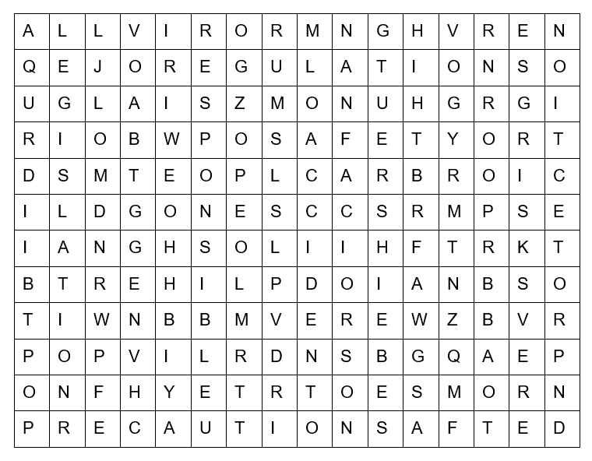
Word Search
1. Hazard
2. Accident
3. Precautions
4. Risks
5. Legislation
6. Regulations
7. Safety
8. Responsible
9. Protection

Slide 7
Word Search
1. Hazard
2. Accident
3. Precautions
4. Risks
5. Legislation
6. Regulations
7. Safety
8. Responsible
9. Protection

Slide 8
Health and Safety Responsibilities
Outline an employer’s health and safety responsibilities after an incident has taken place in a logistic environment
ThePhoto by PhotoAuthor is licensed under CCYYSA.

Slide 9
Procedure
What
to
Do
Investigate cause of the incident
Investigate measures to prevent a reoccurrence
Revisit risk assessment
Report to regulatory body if required
Review training requirements if required
Revisit relevant policies and procedures if required
Review accident records

Slide 10
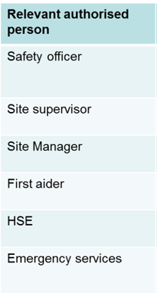
Roles and responsibilities
Looking at these roles what do you think their responsibilities and involvement is when it comes to H&S and incidents?

Slide 11
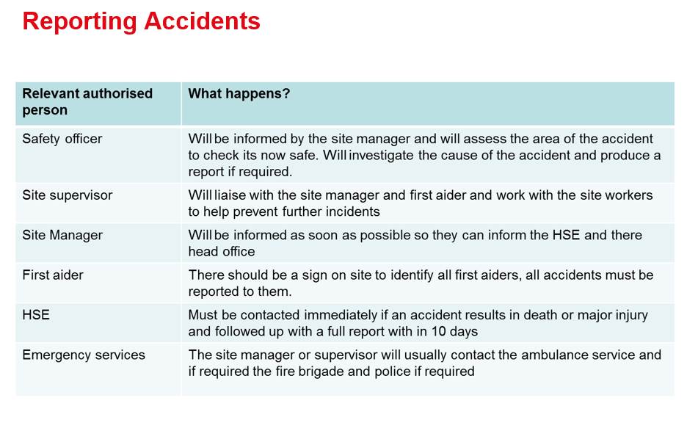

Slide 12
Complete workbook: Working Safely in Logistics
Q5. State what employees should do in response to different health and safety incidents in a logistic environment (3.1)
Q6. Outline an employer’s health and safety responsibilities after an incident has taken place in a logistic environment (3.2)

Slide 13
Next Session
Know how to take responsibility for health and safety in a logistic environment

