Slide 1
Know how to take responsibility for health and safety in a logistic environment

Slide 2
Learning outcomes
Give examples of ways in which an employee can improve own personal wellbeing in a logistics environment (4.1)
Outline ways in which to maintain own workspace in a clean and tidy condition in a logistic environment (4.2)
Give examples of ways in which an employee is responsible for the health and safety of themselves and others in a logistic environment (4.3)

Slide 3
Personal Wellbeing
Give examples of ways in which an employee can improve own personal wellbeing in a logistics environment

Slide 4
Personal Wellbeing
Stay fit and healthy
Take regular breaks
Eat and drink appropriately during work time
Seek support if required
Ask for flexible working arrangements
Use the gym (Some workplaces will have their own)
Avoid damaging conflict
Take part in well-being initiatives (lunchtime walking group)

Slide 5
Drivers Health and Welfare
The Battle Against Fatigue
Lorry drivers spend long days on the road which can be dangerous as concentration levels are bound to dip after a few hours.
Added to long hours is the stress that many face on a daily basis because of the volume of traffic and delays which impact on many who battle against fatigue, and struggle to maintain concentration levels at all times.
If someone has a lull in concentration in the office it’s likely that it will go unnoticed, but on the road one dip in concentration can be fatal.
Learner discussion: What is fatigue and how do you think a lorry driver could avoid its effects?.

Slide 6
Drivers' Health and Welfare
Lifestyle
It is importance that drivers manage their health and fitness while driving at work. By having regular medical check-ups and licence reviews it ensures their own safety and that of the public from occupational and lifestyle-related health issues.
Sitting in a lorry for the majority of the day can be detrimental to a driver’s health. Food choices can often be limited and for the long distance lorry driver, sleeping in the cab, a healthy lifestyle isn’t so easy.
Another unhealthy element can be spending a long time in isolation and away from home. Dealing with mental turmoil only makes the other issues even more difficult to deal with.
Activity: Discuss in groups how a professional Lorry Driver can avoid an unhealthy lifestyle.

Slide 7
Drivers' Health and Welfare
Companies will have policies and procedures in place which give information and guidance on driving, licence checking and vehicle operation.
It is the drivers' responsibility to ensure they remain safe and legal at all times.
For example, having regular eye tests

Slide 8
Drivers Health and Welfare (Drinking and Drugs)
Drinking and driving is against the law, and you must never drive under the influence of drugs. You should even avoid driving after taking some types of medication, because certain medicines can alter your mental state or make you drowsy.

Slide 9
Drivers Health and Welfare (Drinking and Drugs)
The facts:
Every year, about 90,000 people are convicted of drinking and driving
The law does not treat illegal drugs and prescription medicines differently
Drug driving is considered to be as serious as drink driving, and the penalties are the same
Drugs affect your ability to drive in many ways
Activity: What do you think might happen if you are caught under the influence of drink or drugs when driving if you are employed as a professional lorry driver?.

Slide 10
Drivers Health and Welfare (Stress)
Stress at the wheel is a major problem for many drivers. A Direct Line survey of UK drivers found that 71% had lost concentration at the wheel in the past year due to stress or annoyance. This risks the lives of drivers and other road users. Combating stress while driving is essential.
https://youtu.be/2WjO62pPSjs
Activity:
What do you think could be some of the causes of stress as a lorry driver?
What could be some of the signs and symptoms that we are stressed?
What do you feel we can do to combat the feeling of stress and who can help us?.

Slide 11
Maintaining the workspace
Outline ways in which to maintain own workspace in a clean and tidy condition in a logistic environment

Slide 12
Maintain own workspace
Important for avoiding accidents and maintaining effective and efficient productivity
Throw away rubbish correctly
Clean work area at least daily
Don’t eat at place of work
Don’t stock pile
Follow organisational guidelines
Reduce clutter
Store equipment safely

Slide 13
Employee responsibility
Give examples of ways in which an employee is responsible for the health and safety of themselves and others in a logistic environment

Slide 14
Employee responsibility
Take reasonable care
Co-operate with an employer
Report incidents/accidents
Report hazards
Avoid wearing inappropriate clothing
Cover long hair
Insist on proper training
Using protective equipment where provided
Report the use of medication

Slide 15





Five Types of Signs
Most safety signs, flooring instructions and symbols fall into one of four categories:
Prohibition
Warning
Mandatory
Safety
COSHH

Slide 16








Signs
Long term health Hazard
Flammable
Explosives
Dangerous for the environment
Gas under pressure
Corrosive
Health Hazard
Oxidising
Toxic
These should all be taken into consideration when writing up your Risk Assessment

Slide 17





Scaffolding incomplete Do not use
No escape route
No pedestrians
Children must not play on this site
No Smoking

Slide 18
Prohibited Signs
Category | Colour | Information/ Instruction | Features | Examples
Prohibition | Red | Dangerous behaviour Stop Shutdown Emergency cut-out devices Evacuate | Round shape Black Pictogram on white background Red edging with a red diagonal line | Do not touch No access for unauthorised persons Do not enter

Slide 19








Explosive
Fragile roof
General Warning
Corrosive
Danger of electrocution
Forklifts at work
Flammable
Toxic

Slide 20
Warning Signs
Category | Colour | Information/ Instruction | Features | Examples
Warning | Yellow | Be careful Take precautions Hazard nearby | Triangular shape Black pictogram on yellow background Black edging | Electric shock General warning Magnetic Field Biological Hazards

Slide 21

M1 – General Mandatory
M2 – Safety helmet must be worn
M3 – Safety glasses must be worn
M4 – Face shield must be worn
M5 –Face mask must be worn
M6 – Respirators must be worn
M7 – Ear protection must be worn
M8 – Hand protection must be worn
M9 – Safety boots must be worn

Slide 22
Mandatory Signs
Category | Colour | Information/ Instruction | Features | Examples
Mandatory | Blue | Specific behaviour or action | Round shape White pictogram on blue background | Wear safety glasses Wash hands Use safety harness

Slide 23





Assembly Point
Emergency shower
Emergency eyewash
Wash your hands
First aid

Slide 24
Safety Signs
Category | Colour | Information/ Instruction | Features | Examples
Emergency | Green | Doors Exits Escape routes Equipment and facilities | Rectangular or square shape White pictogram on green background | Emergency exit/escape route First aid kit Eye Wash Station

Slide 25





Fire alarm point
Fire Ladder
Firefighting equipment
Fire extinguisher
Fire hose

Slide 26
Fire Fighting Signs
Category | Colour | Information/ Instruction | Features | Examples
Firefighting | Red with white lettering | Gives information about extinguishers, hydrants, hoses and fire alarm call points | Rectangle shape Red background with white images and lettering | Fire alarm point Fire extinguisher

Slide 27
How fires start
Fire needs three things to burn:
Fuel
Heat
Oxygen
If all these are present a fire will spread
Fire extinguishers work by fighting one or more sides of this triangle

Slide 28
Fire extinguishers
Distance
When setting an extinguisher off you should be between the below distance.
The 30-metre rule comes from current UK British Standards (BS 5306) and states that you should be no more than 30 metres from the appropriate extinguisher
What are these distances in inches?

Slide 29
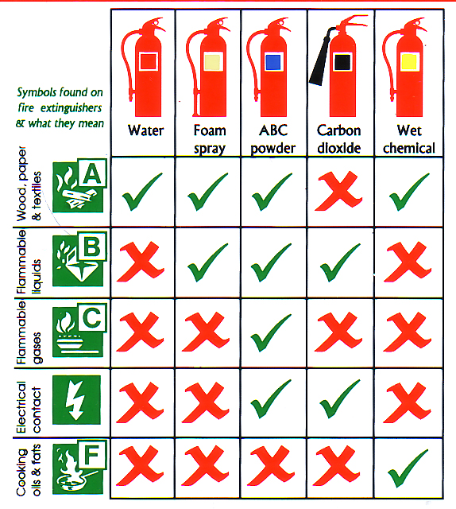
Know Your Fire Extinguishers
Extinguishers should be serviced every 12 months. Looking at the dates of the last service, when should they be next serviced?
02/05/2022
14/04/2022
10/06/2020
15/07/2021
23/08/2021
02/05/2023
14/04/2023
Late ASAP
Late ASAP
Late ASAP

Slide 30
Activity
Produce a Health and Safety poster for a new employee working in Logistics.
This should cover:
Employee and Employer responsibility
Common causes of accidents
How workers can reduce risks
A list of 5 different potential hazards and the signs used to identify the hazards. You must use at least 1 mandatory sign, 1 prohibition sign, 1 warning sign, 1 COSHH sign and 1 safe conditions sign

Slide 31
Complete workbook: Working Safely in Logistics
Q7. Give examples of ways in which an employee can improve own personal wellbeing in a logistics environment (4.1)
Q8. Outline ways in which to maintain own workspace in a clean and tidy condition in a logistic environment (4.2)
Q9. Give examples of ways in which an employee is responsible for the health and safety of themselves and others in a logistic environment (4.3)

Slide 32
Next Session
Know about the environmental impact of logistics

