Slide 1
Know about the environmental impact of logistics

Slide 2
Learning outcomes
Give examples of the impact on the environment of:
Storing goods
Transporting goods (1.1)

Slide 3
Environmental considerations and the impact on industry
Introduction
​When you think about the environment in terms of road traffic, you might start imagining exhaust fumes and CO2 emissions and HGVs understandably have a greater impact than other vehicles on the road.
Activity: Take 5 minutes and write down what you feel are the environmental impacts and considerations with regards to Logistics and lorry driving and be prepared to share your thoughts with the group
Group discussion

Slide 4
Environmental Impact
Carbon footprint
Air and noise pollution
Fossil fuel burning
Global warming
Greenhouse gases
Acid rain
Smog
Creation of waste
Poor water quality
In 3 breakout rooms each group are given 3 headings.
Research the 3 headings to feedback to the whole group what they each mean and how logistics has a contribution. 10 Minutes

Slide 5
Impact on the environment of storing goods
Thinking about the environmental impact we just discussed, consider how the below could have an impact on the environment when storing.
Group 1 | Group 2
Impact of land purchase Loss of heat through structures Distance from storage to customer | Excessive heating Poor power saving regime & energy management Use of materials handling equipment (e.g. forklift)

Slide 6
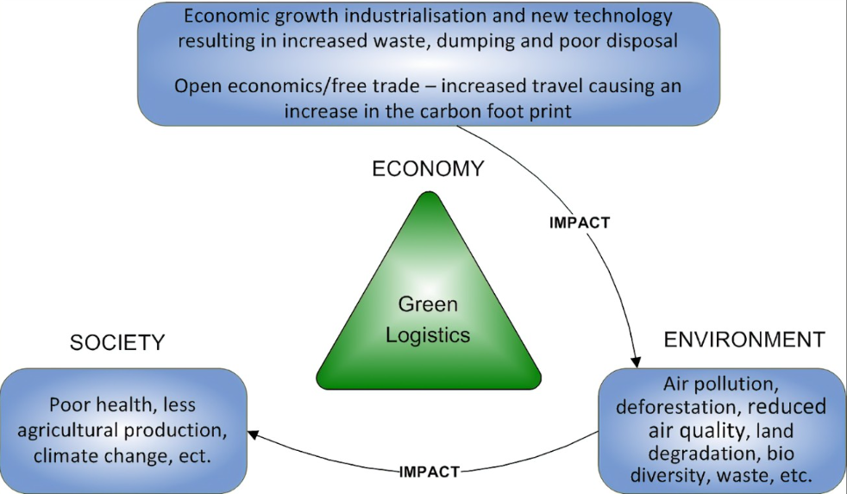

Slide 7
Methods for transporting goods
What methods are there for transporting goods?

Slide 8
Impact on the environment of transporting goods
Impact of transporting goods by:
Road,
Rail,
Air,
Sea

Slide 9
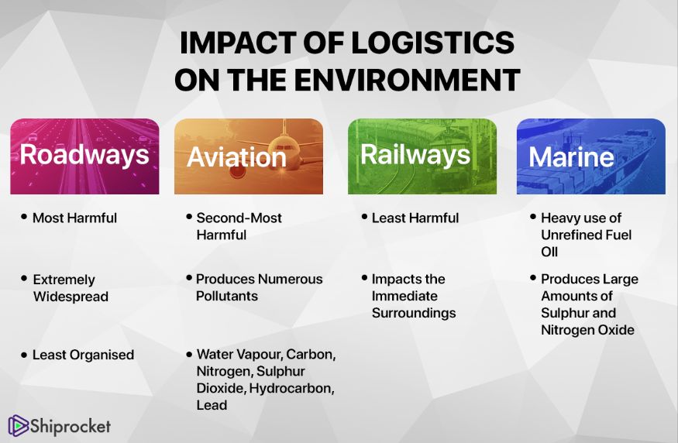

Slide 10
Task
Thinking about the last item you ordered online.
Where did it come from?
How many modes of transport did it take for it to arrive at your door?
How did that item have an impact on the environment?

Slide 11
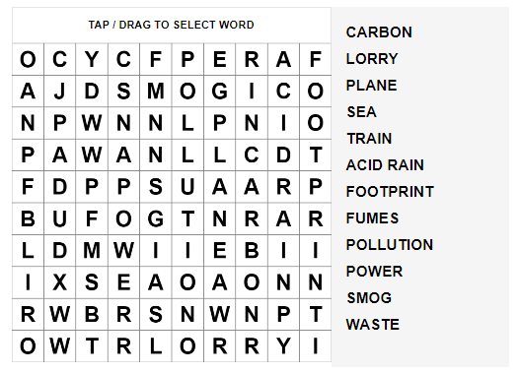
Activity

Slide 12
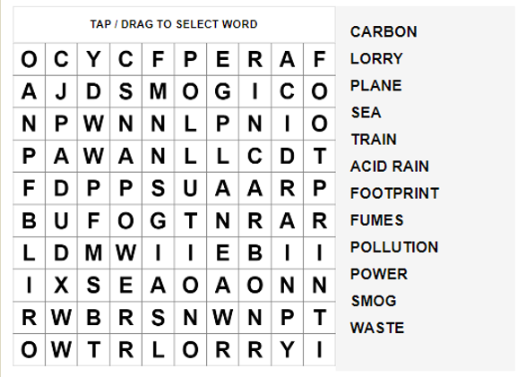
Answers

Slide 13
Online Game
The Climate Game — Can you reach net zero? (ft.com)

Slide 14
Complete workbook: Environmental Impact of Logistics
Q1. Give examples of the impact on the environment of:
Storing goods
Transporting goods (1.1)

Slide 15
Next Session
Know about reducing the environmental impact of logistics

